Slide 1
UltraLite Coding
Presents: Banqi
Nicholas Walter
Max Maier
Tyler Hogenson
Ben Finnerty
Spencer Lofing

Slide 2
Table of Contents
Complete Use Case Diagram
A diagram of all use cases representing the entirety of the system.
Description of Banqi
An explanation of the history of the game, its rules, and how to play it.
Process/Product Decisions
All decisions we have made regarding our process and the product.

Slide 3
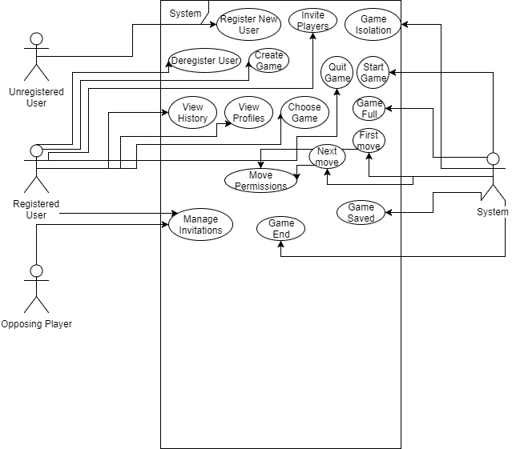
Complete Use Case Diagram
<use case diagram goes here>

Slide 4
History of Banqi
Built as a variant of Liubo and Chinese Chess, Banqi is “half chinese chess”. It plays similar to chinese chess, but on only half the board.
Banqi also goes by the names Dark Chess or Blind Chess, as the game begins with all the pieces in random positions and face down.
It was made famous by Niu ZengYu of the Tang Dynasty.
He wrote in a work of his that he came across a family with two odd looking mandarins growing in their garden. Each was as big as a bowl, and inside were two old men playing Banqi.
Since then Banqi has been played in many cultures and by many groups of people, making it a very popular game. It’s mostly a social game, very rarely played competitively.

Slide 5
Rules of Banqi
Pieces start shuffled and face-down
First player turns up a piece, which determines what their color will be (either black or red)
During a player’s turn, they can do one of three things:
Turn over a face-down piece
Move a face-up piece to an adjacent unoccupied space
Capture an enemy face-up piece
To capture a piece, that piece must be of lower rank than the one you are using to capture with. There are exceptions to this rule:
The general cannot capture a soldier, and soldiers may capture the general
The cannon can take any ranking piece, but to do so it must be able to jump over another piece (and only 1 piece). This jump can travel as many squares as needed.
The games ends when a player cannot make a move, and that player is the loser for that game
Pieces: 7) General x1 6) Advisor x2 5) Elephant x2 4) Chariot x2 3) Horse x2 2) Cannon x2 1) Soldier x5

Slide 6
Process/Product Decisions
Browser accessible GUI
Ideas for online functionality:
Spring Framework MVC
Jetty Server
AngularJS
Agile Development Methodology

